Slide 1
Soft Computing(SWE1011)
J Component Review-3
Project Team:
20MIS1011 Kaviya S
21MIS1035 Rashmita Y
21MIS1017 Raj Koyani
21MIS1135 Abijith A

Slide 2
Modules
Backend:
Image Preprocessing: Resizes the image to a standard size. Converts the image to a suitable format for the deep learning model. Applies data normalization or augmentation techniques like ImageDataGenerator functionality for the model so after it is trained it will do Image Preprocessing
Deep Learning Model: Trained on a large dataset of labeled eye disease images. Using convolutional neural networks (CNNs) the predictions are done for the type of eye disease.
Result Processing: Interprets the model's output and translates it into user-friendly language.
API Communication: Frontend communicates with the backend through an API. Sends the image data and receives the analysis results.
Frontend:
Image Upload: Input field for selecting an image file from the user's device. Support for various image formats (e.g., JPEG, PNG). Validation to ensure file size and type are within acceptable limits.
Predict Button: Initiates the image analysis process upon user click.
Results Display: Presents the predicted disease or shows if its healthy. It has clear and concise language, avoiding medical jargon where possible.

Slide 3
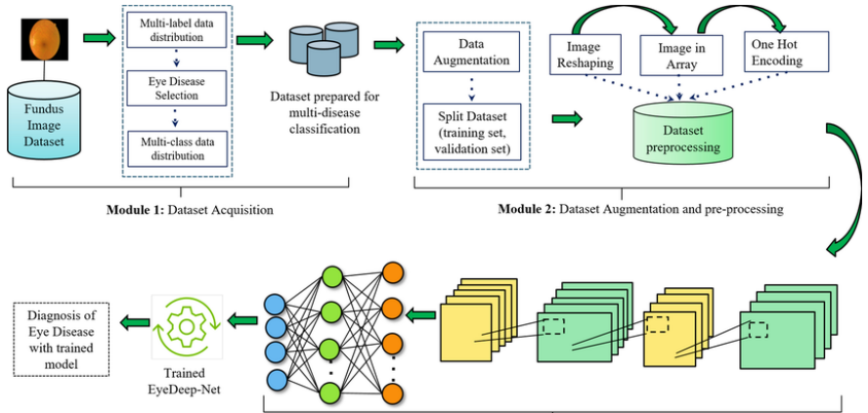
Flow/Block Diagram

Slide 4
Progress until Review-2
The primary goal of our project is to develop an accurate and robust deep learning model for the classification of various types of eye diseases, specifically focusing on Normal, Cataract, Diabetic Retinopathy, and Glaucoma.
So, keeping that in mind we developed a eye disease detecting model using Restnet59
We have used ImageGenerator for the preprocessing of dataset so that it can easily segregate into the 4 classes which are Glaucoma, Diabetes Retinopathy, Cataract and normal.
So far we have trained the model, saved the results into a flask model and tested the model and obtained the following results:
Class-level accuracies:
cataract: 0.8618
diabetic_retinopathy: 0.9822
glaucoma: 0.7344
normal: 0.8266

Slide 5
Progress until Review-2
Next, we have used HTML, CSS, JavaScript for the frontend of our website.
We ran the model with 50 epochs and 99 rounds in each epoch. The optimiser we used was Adam and crossentropy as the loss function and obtained excellent results and an accuracy of 95%
By Review-3
Further by the time of complete model deployment in review 3 we would integrate the frontend and backend using the flask and streamlit and display our final results.
Using the local host and the saved model’s file, we will host the model into a full fledged working website

Slide 6
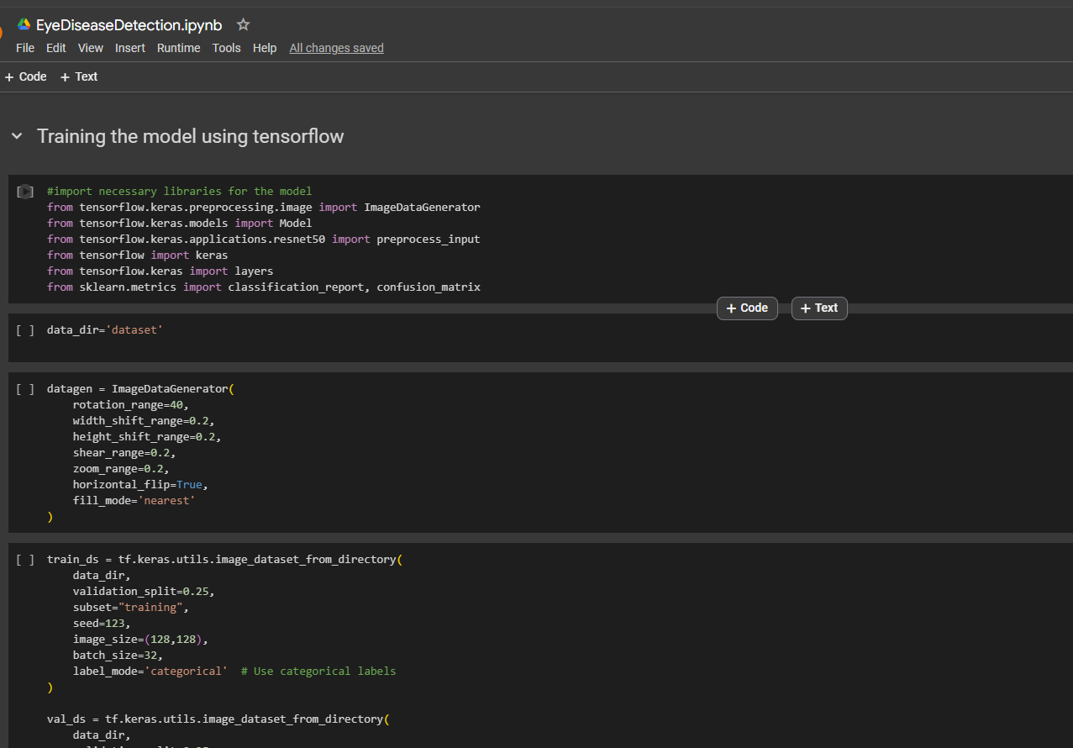
Training the Model

Slide 7
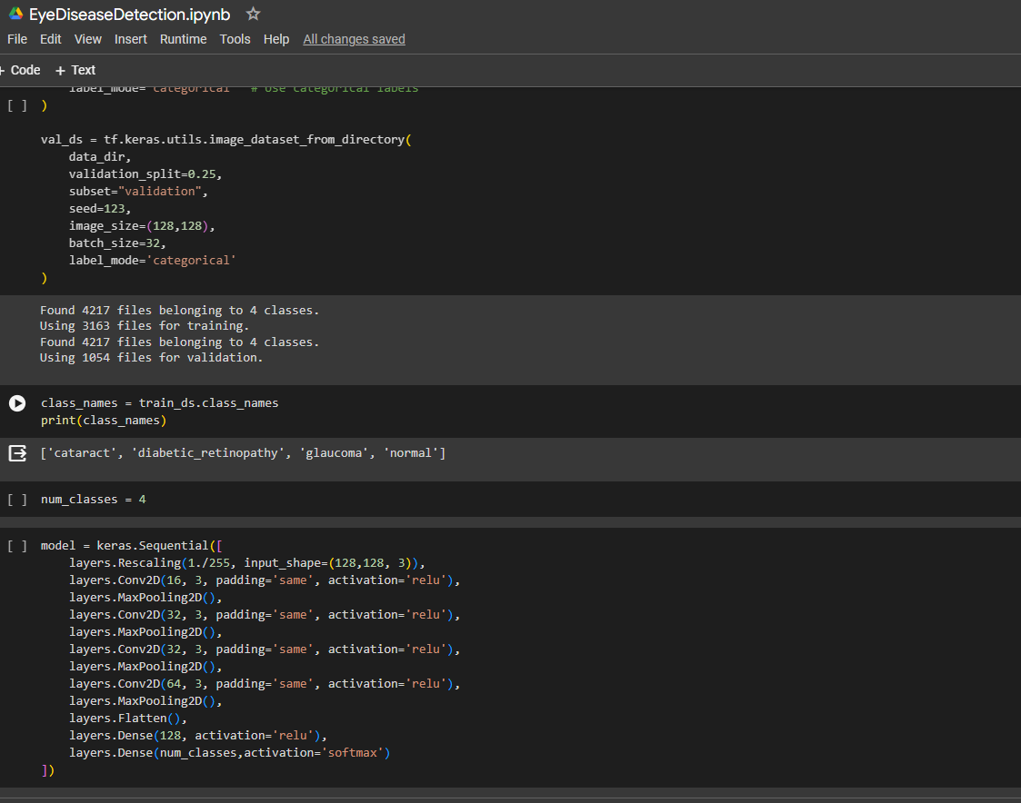
Training the Model

Slide 8
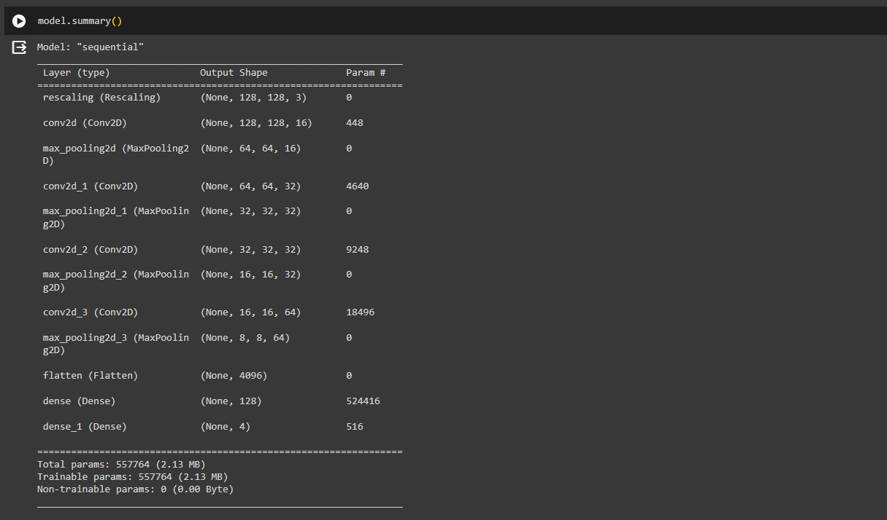
Model Summary

Slide 9
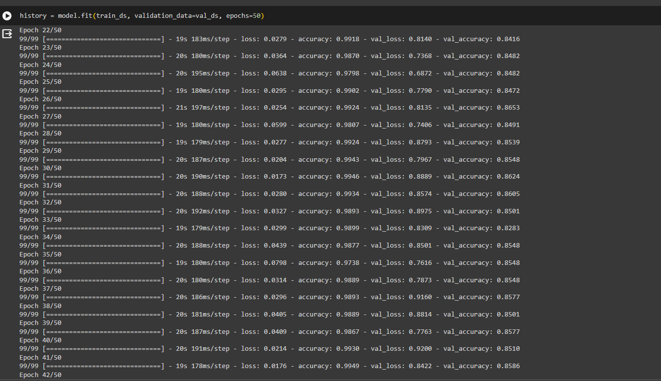
Model training

Slide 10
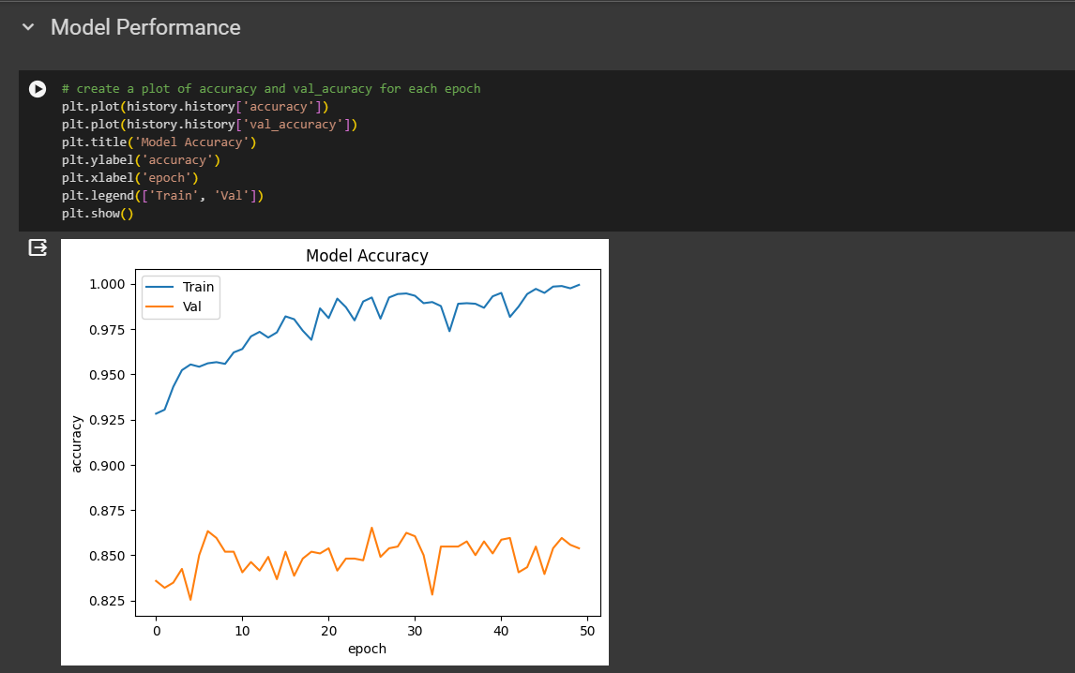
Evaluating Model Performance

Slide 11
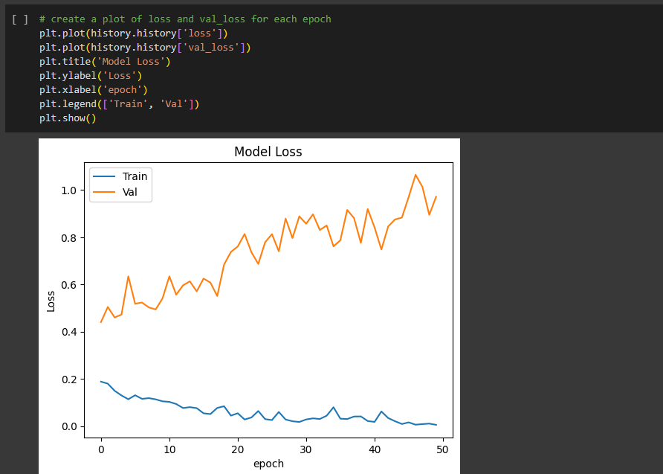
Evaluating Model Performance

Slide 12
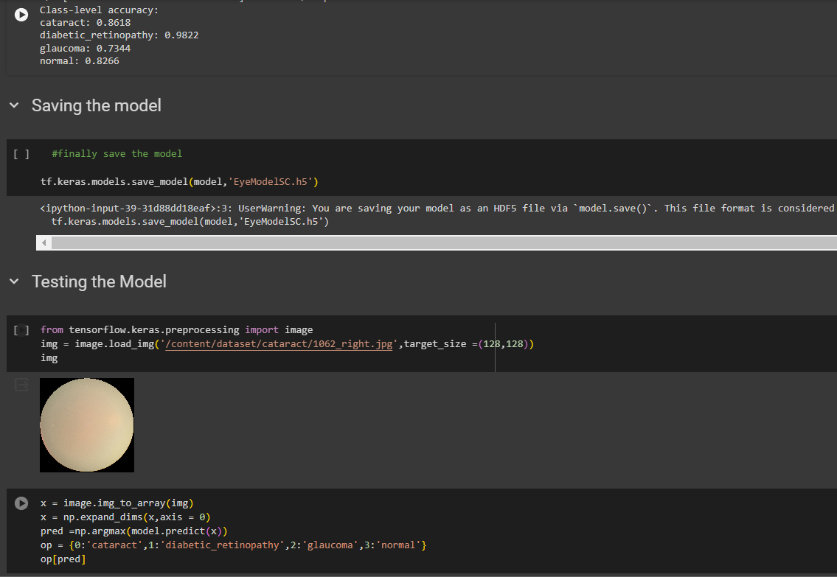
Saving the Model and Testing

Slide 13
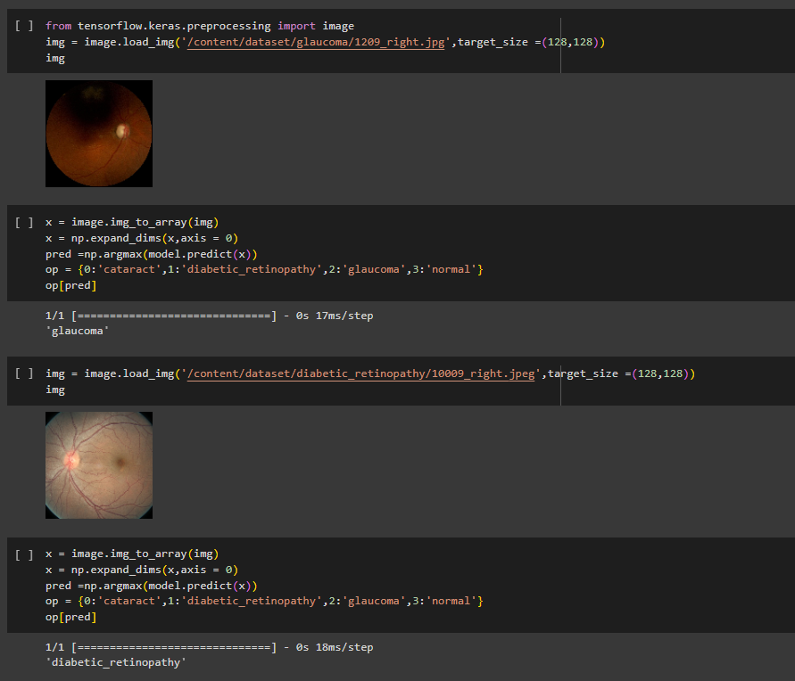
Results

Slide 14
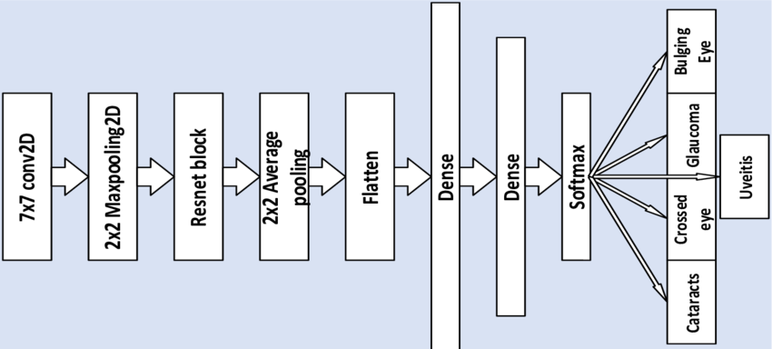

Architecture Diagram
Normal
Diabetic Retinopathy

Slide 15
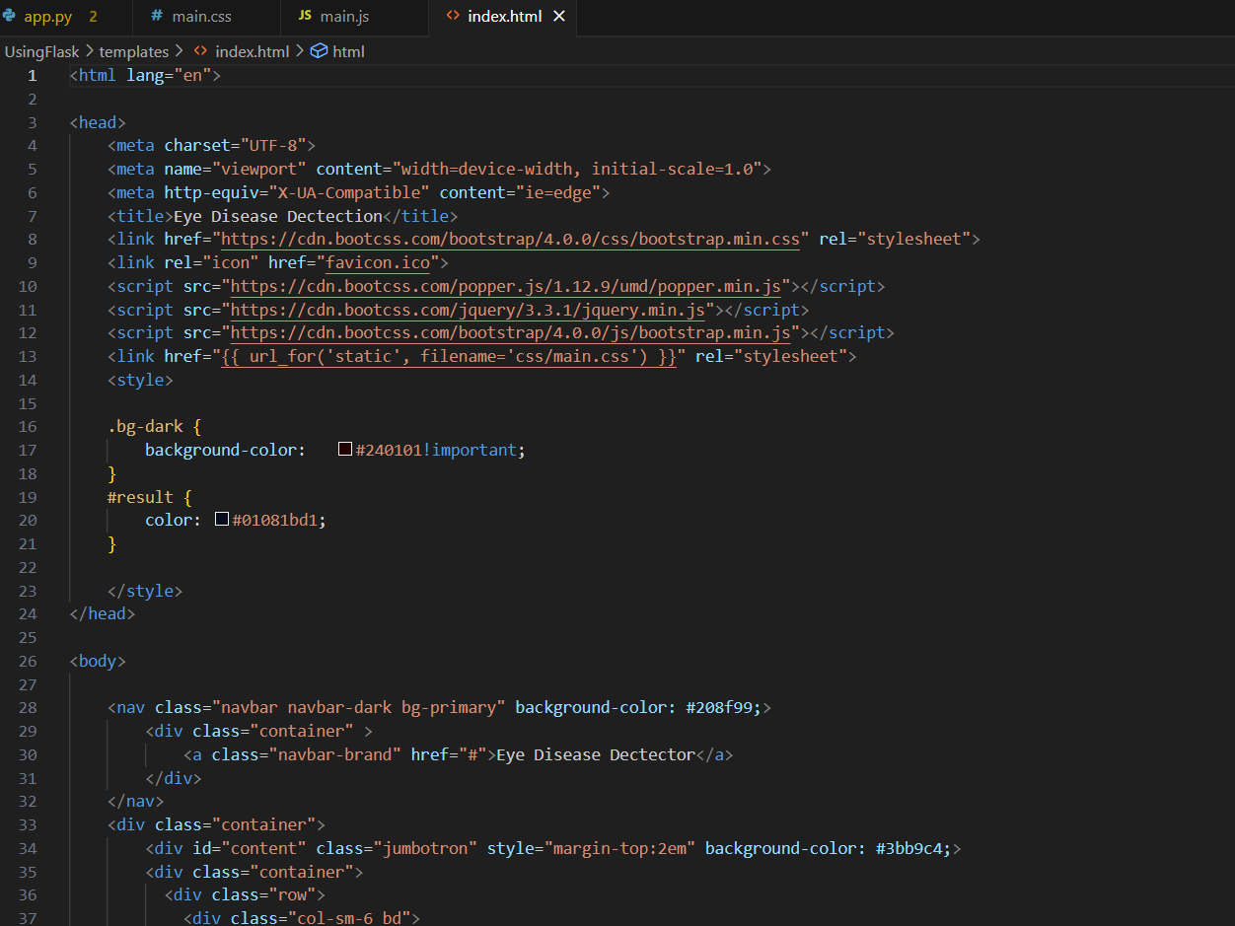
Frontend Development using Flask

Slide 16
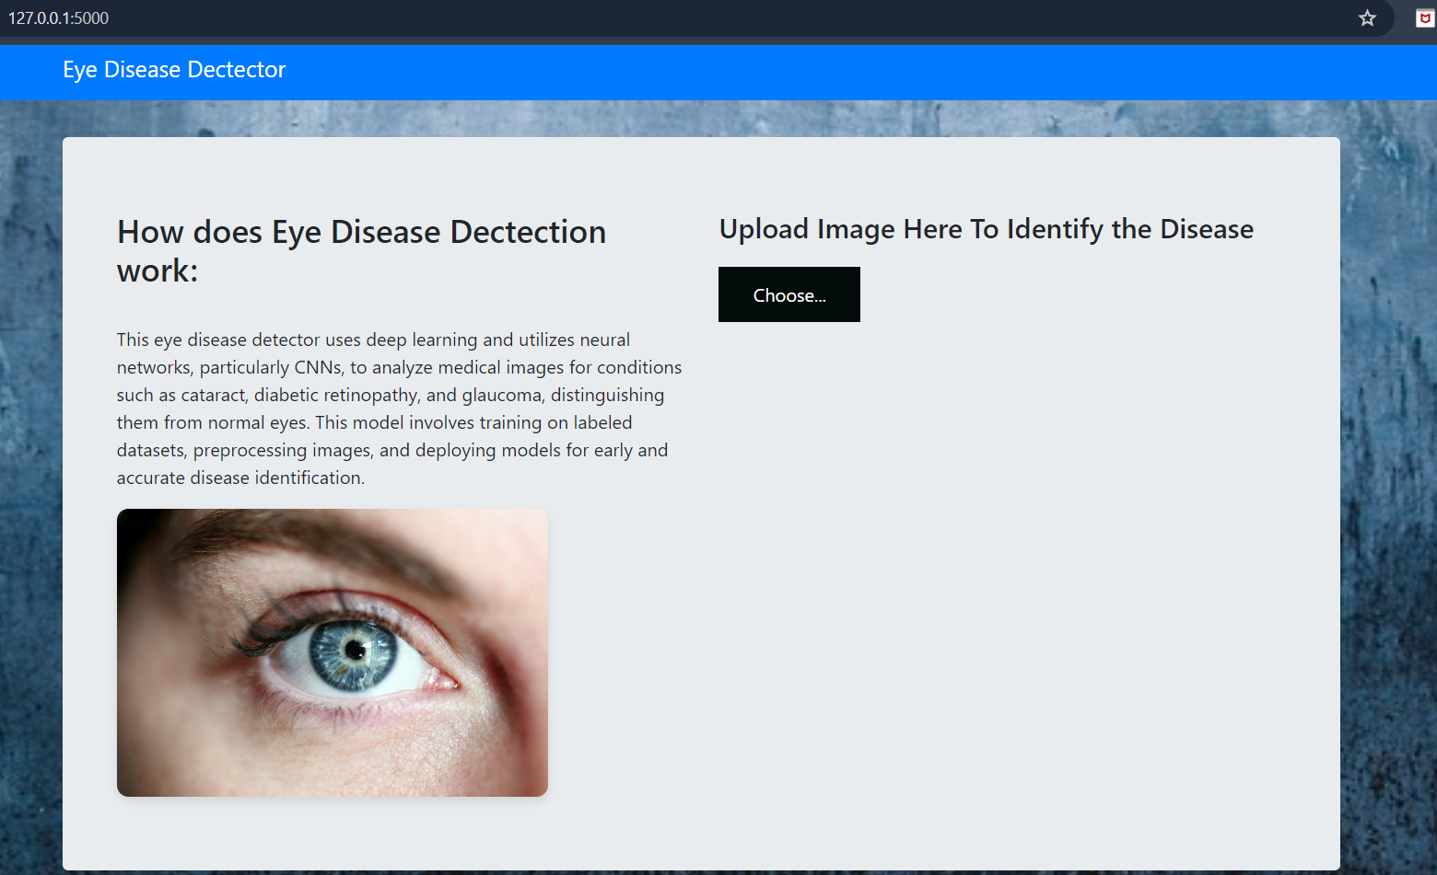
Frontend Development
Using the Flask Software and the saved model’s file, we have hosted the model into a working website on local host and this is our simple Interface

Slide 17
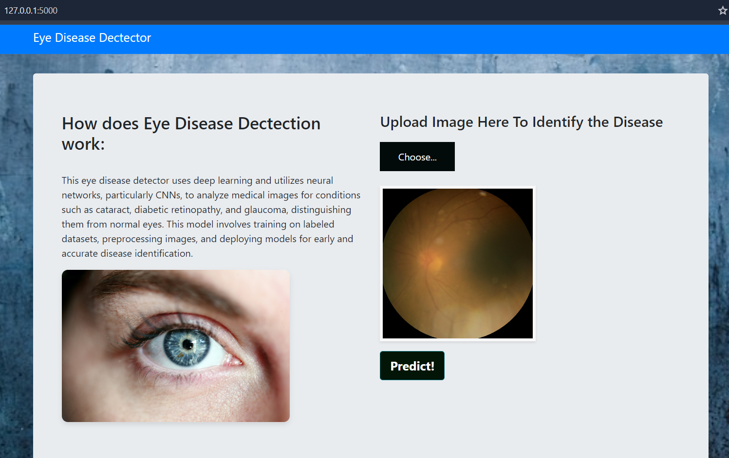
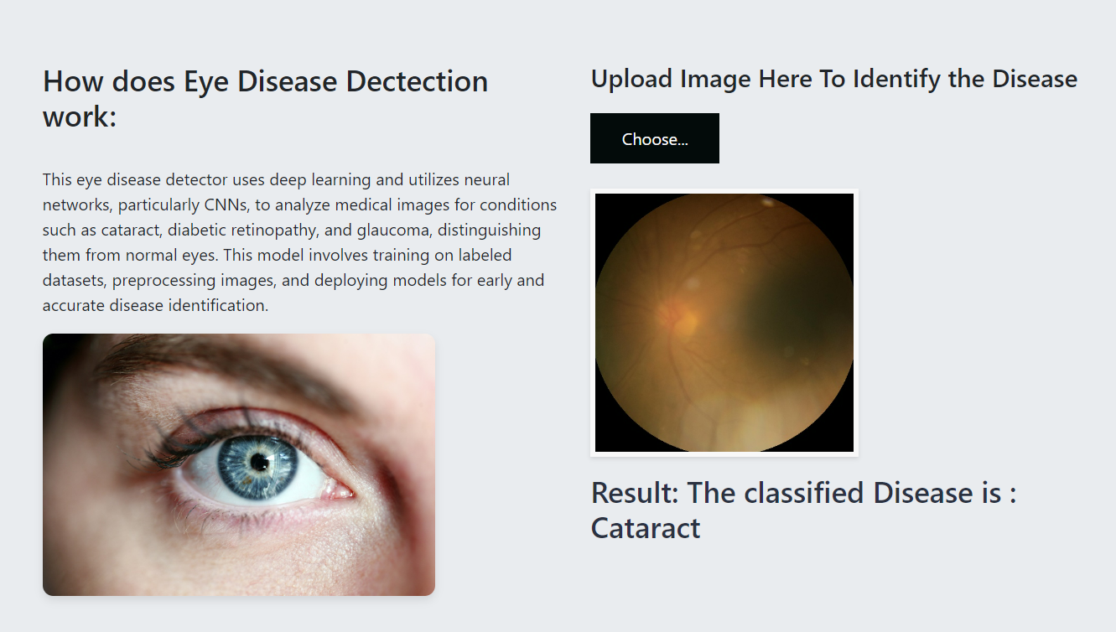
Frontend Development
We can choose an image and click on predict, which will give us the predicted results
Hence, The disease detected is Cataract

Slide 18
Conclusion
Successful Implementation: We have successfully implemented a deep learning model that leverages the strengths of pre-trained VGG16 for feature extraction and potentially utilizes LSTMs for capturing sequential information in the data.
Promising Approach: This approach demonstrates the feasibility and potential of deep learning in eye disease detection tasks.
Successfully Deployed the Model: We developed and deployed the model using Flask which helps the users to detect eye diseases
Future Scope
Real-World Deployment:
Web or Mobile Application: We can explore deploying our model as a web application accessible through a user-friendly interface. This would allow users to upload retinal images for disease screening.
Integration with Medical Systems: Investigate potential integration with existing medical imaging systems used in hospitals or clinics, making the model accessible to healthcare professionals for diagnosis support.
Scalability and Security: Consider the challenges of scalability and security when deploying your model in a real-world setting. This could involve cloud computing solutions and robust security measures to protect sensitive patient data.

Slide 19
Thank you

